Slide 1
Friends and Peers Looking Out for Each Other
Notes:
Let's talk about how our friends and how our classroom peers can look out for each other.

Slide 2
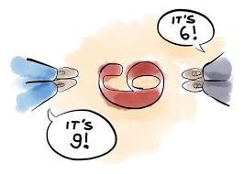
Notes:
Sometimes it can be hard to see what others see depending on how we look at a situation. Our friends, classmates, teachers, and parents can point out something different that we might not have noticed before.

Slide 3
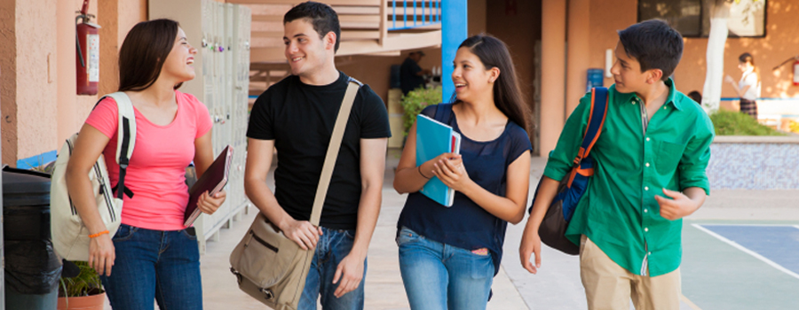
Notes:
The same can be applied to identifying red flags of a trafficker. Traffickers know how to build a relationship of trust with individuals very quickly. Our friends and school peers can look for red flags to help keep each other safe to prevent sex trafficking.

Slide 4


Notes:
Whether you're walking down the hallway or hanging out with friends, if you see any red flag or hear something that sounds like a red flag, speak to a trusted adult.
If a classmate or friend said something that does not seem right, speak to an adult who will help make sure they are safe. If a friend or classmate asks you to keep a secret, but you are worried about them, don’t be afraid to speak to a trusted adult.

Slide 5





Notes:
Some read flags we can look out for from our peers are, are they
isolating more (Like, are they not hanging out with you and are spending more time with a boyfriend or girl friend or a new set of friends?)
Do they have an older boyfriend or girlfriend?
Do they have new items (like a phone, backpack/purse, shoes, clothes, hair style, nails done, etc.) that you know they can't afford?

Slide 6
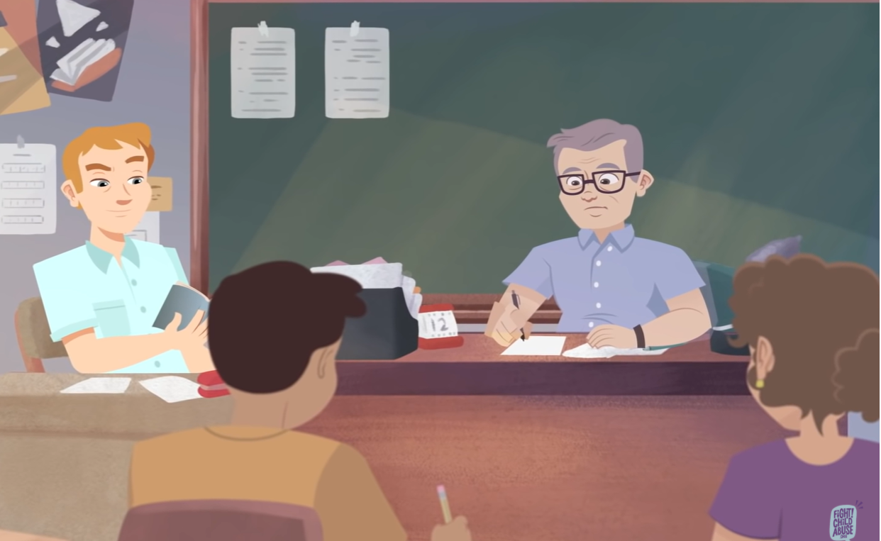

Video 1: Friends can Help
Share: what red flags can you identify?
Notes:
https://www.youtube.com/watch?v=c3L0iKqCaC0
Red flags:
“He was older, like a lot older”
Dating an older guy, “We’re just hanging out”
Hanging out at school, after school, and DMs = isolation (DMs-Direct Messages, a private messaging feature on Twitter. They are inherently more personal, intimate, and exclusive than a public post, since no one can see them but the sender and recipient, who often must be already following each other on the social media platform.)
Ignoring, disappearing for weeks = isolation
“He doesn’t want me to talk about me and him” or talk to friends = rules
Checking phone
Coercion = good grades in English

Slide 7
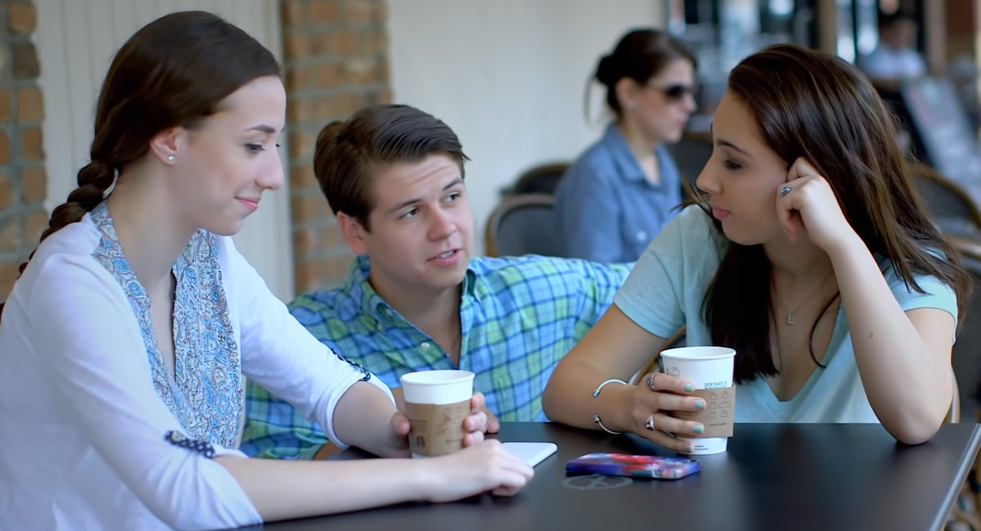

Video 2: Friends can Help
Share: what red flags can you identify?
Notes:
https://www.youtube.com/watch?v=TJKMPrSODfQ
Red flags:
Older guy at coffee shop
Older guy complementing girls
Older guy inviting girls to a party
Exchanging numbers
Older guy picking up girl
“Sweetie” nick name
Nice car
Presents
“Asking girl” to help him get money so his car isn’t taken away
Dating other older guys
New clothes
Tired
Missing school
Drinking alcohol
Not returning friends calls

Slide 8
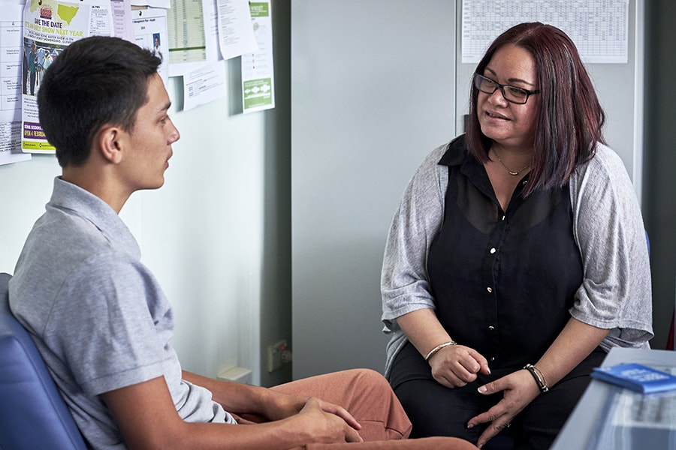
Notes:
If you notice something is different about your friend, ask them about it.
Where did you get that purse? How did you meet your boyfriend? How old is your boyfriend?
Always seek help from a trusted adult and know that you are not going to get into trouble. Getting help from an adult means that you are concerned about your friend's safety.

